Slide 1

World Electricity Analysis
World Electricity trends relying on the percentage from year (1960-2020)

Slide 2
About the Data
Data of world Electricity in raw form
Clean the data From Python and analysis with SQL
Comparison of difference Access Rural ,Urban and Total of Rural and Urban
There are 3 different Electricity production like –Nuclear Source , Oil Source,
Renewable Source
Electric power transmission and distribution losses is the part of analysis
Analysis the data according to Country wise ,Region wise ,Income Group

Slide 3
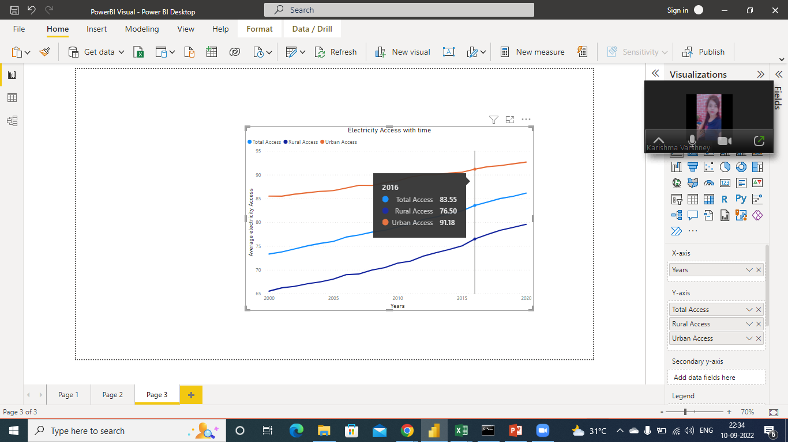
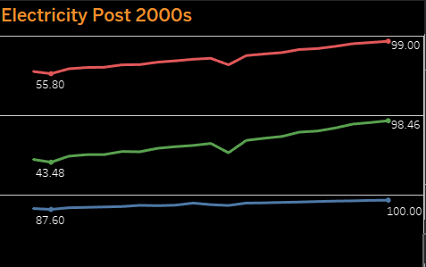
Comparison of access to electricity post from 2000-2020 in different countries
After the comparison we got the analysis
India –Electricity of rural was low in 2001-43.48 % and high in 2020-98.46%
India –Electricity of Urban was low in 2001-87.60 % and high in 2020-100.00%
India–Electricity of Total was low in 2001-55.80 % and high in 2020-99.00%

Slide 4
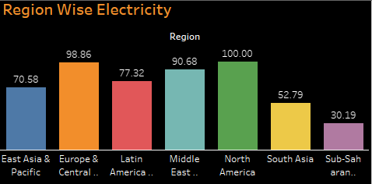
Total world electricity show as the region wise
After the analysis we can say that minimum electricity use in Sub-Saharan-Africa 30.19 of overall population of Sub-Saharan-Africa.
Maximum electricity use in North –America 100.00 of overall population of North –America.

Slide 5
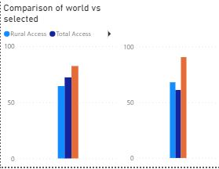
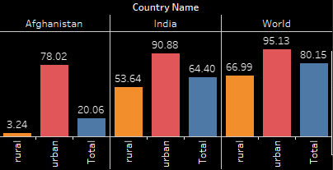
Compare every country’s performance with respect to world average for every year.
Compare of world with India and Afghanistan in year 2004
After Analysis say that rural electricity average access always low then urban and total
Urban electricity average access always high then rural and total

Slide 6
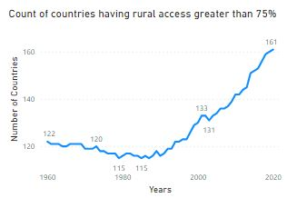
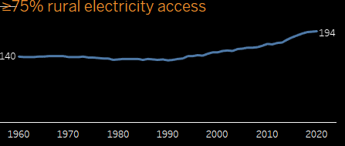
increase in count of country with greater than 75% electricity access in rural areas across different year.
According to electricity access in year 1960 -140 countries have electricity
But electricity access in year 2020 -194 countries have electricity

Slide 7
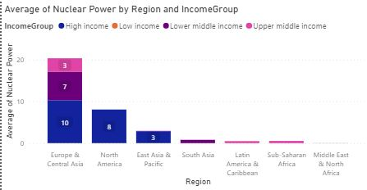
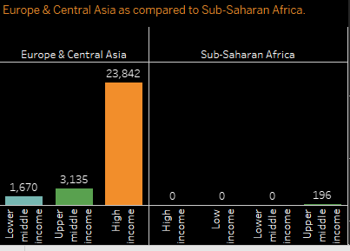
Nuclear power generation in the region of Europe & Central Asia as compared to Sub-Saharan Africa with income group.
After visualization we can say that Sub-Saharan-Africa always how then Europe & Central Asia

Slide 8
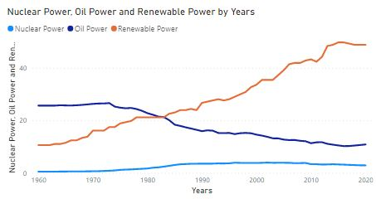
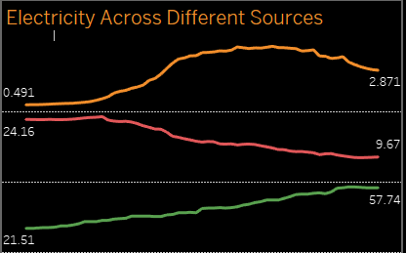
Production of electricity across different sources like –Nuclear Source ,oil Source ,renewable Source .
From the 1960-2020 data where Nuclear Source and oil source 1st increase and then decrease.
But in case of Renewable source always increase like-Solar energy, Wind energy ,Hydropower from flowing water.

